Slide 1
Solving Rubiks Cube
Rei Katsuta
Michal Szczepanski
Malte Hofmann

Slide 2
Introduction

Slide 3
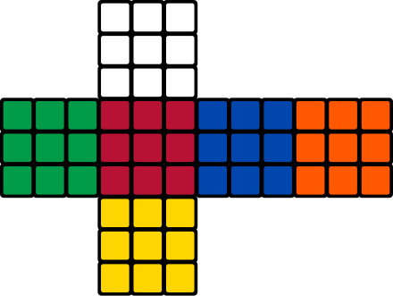
Introduction
Constructed 1974 by Ernó Rubik
"Gods number": 20 moves
World record: 3,14 s
Scientific Computing: Solving Rubiks Cube Malte TU Berlin / Zuse Institute Berlin (ZIB)

Slide 4
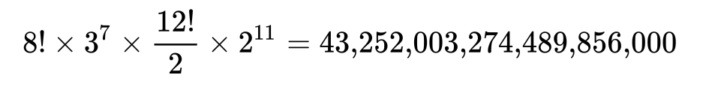
Permutation
Scientific Computing: Solving Rubiks Cube Malte TU Berlin / Zuse Institute Berlin (ZIB)

Slide 5
Cube Topology

Slide 6
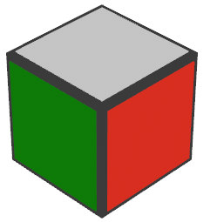
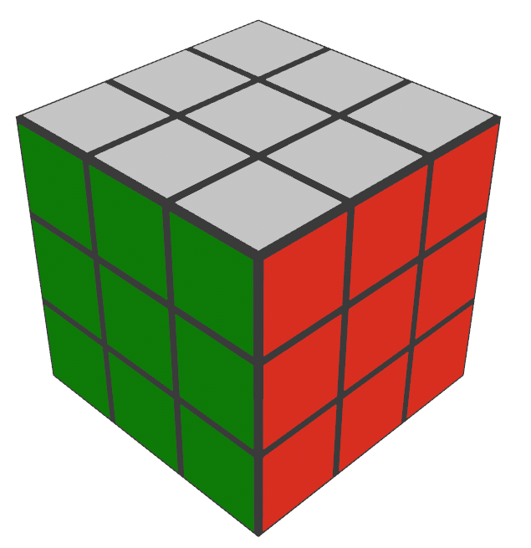
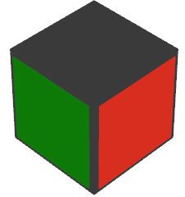

Structure of Cube
8 Corner Cubies
12 Edge Cubies
6 Center Cubies
27 Cubies (26 visible)
Scientific Computing: Solving Rubiks Cube Rei TU Berlin / Zuse Institute Berlin (ZIB)

Slide 7
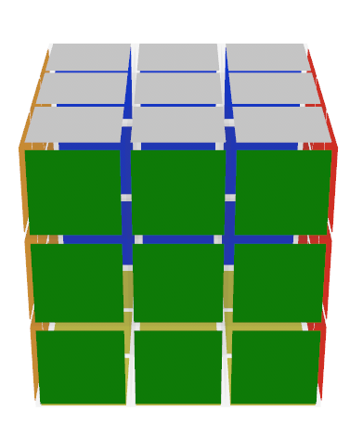
Terms and Notations
6 Standard Rotations:
Scientific Computing: Solving Rubiks Cube Rei TU Berlin / Zuse Institute Berlin (ZIB)

Slide 8
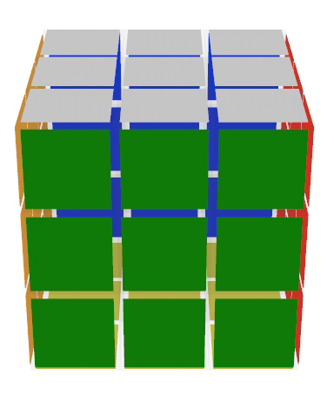
Terms and Notations
6 Standard Rotations:
Up (U)
Scientific Computing: Solving Rubiks Cube Rei TU Berlin / Zuse Institute Berlin (ZIB)

Slide 9
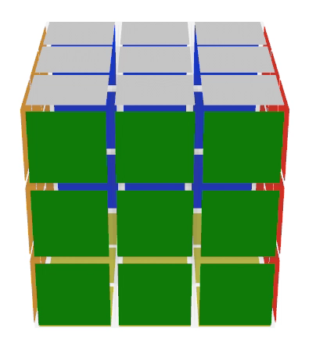
Terms and Notations
6 Standard Rotations:
Up (U)
Down (D)
Scientific Computing: Solving Rubiks Cube Rei TU Berlin / Zuse Institute Berlin (ZIB)

Slide 10
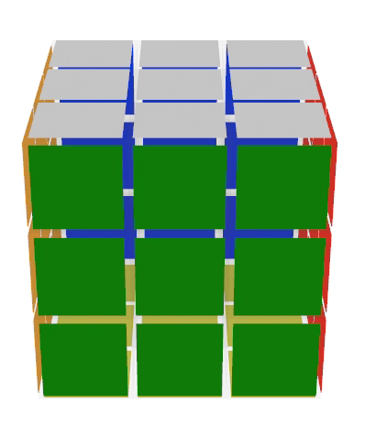
Terms and Notations
6 Standard Rotations:
Up (U)
Down (D)
Front (F)
Scientific Computing: Solving Rubiks Cube Rei TU Berlin / Zuse Institute Berlin (ZIB)

Slide 11
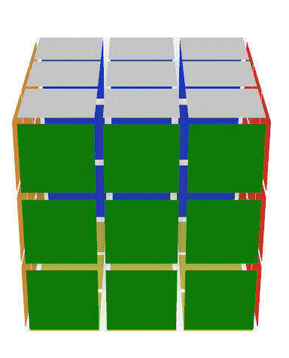
Terms and Notations
6 Standard Rotations:
Up (U)
Down (D)
Front (F)
Back (B)
Scientific Computing: Solving Rubiks Cube Rei TU Berlin / Zuse Institute Berlin (ZIB)

Slide 12
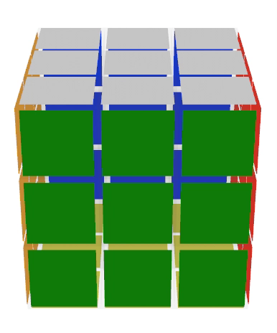
Terms and Notations
6 Standard Rotations:
Up (U)
Down (D)
Front (F)
Back (B)
Left (L)
Scientific Computing: Solving Rubiks Cube Rei TU Berlin / Zuse Institute Berlin (ZIB)

Slide 13
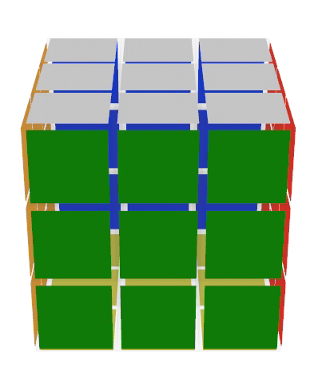
Terms and Notations
6 Standard Rotations:
Up (U)
Down (D)
Front (F)
Back (B)
Left (L)
Right (R)
Scientific Computing: Solving Rubiks Cube Rei TU Berlin / Zuse Institute Berlin (ZIB)

Slide 14
Terms and Notations
6 Standard Rotations:
Up (U)
Down (D)
Front (F)
Back (B)
Left (L)
Right (R)
Double moves (R2)
Counterclockwise (R’)
Scientific Computing: Solving Rubiks Cube Rei TU Berlin / Zuse Institute Berlin (ZIB)

Slide 15
CFOP Method

Slide 16
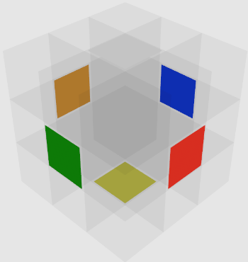
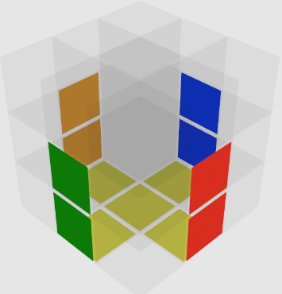
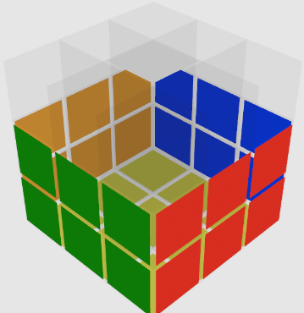
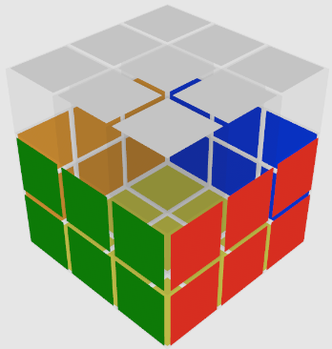
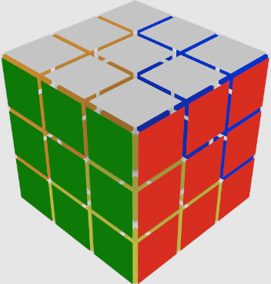
Introduction
Developed in 1980s by Jessica Fridrich
Popular among professional cubers
Stands for:
Cross
First 2 layers (F2L)
Orientation of Last Layer (OLL)
Permutation of Last Layer (PLL)
cross
F2L
OLL
PLL
Scientific Computing: Solving Rubiks Cube Rei TU Berlin / Zuse Institute Berlin (ZIB)

Slide 17
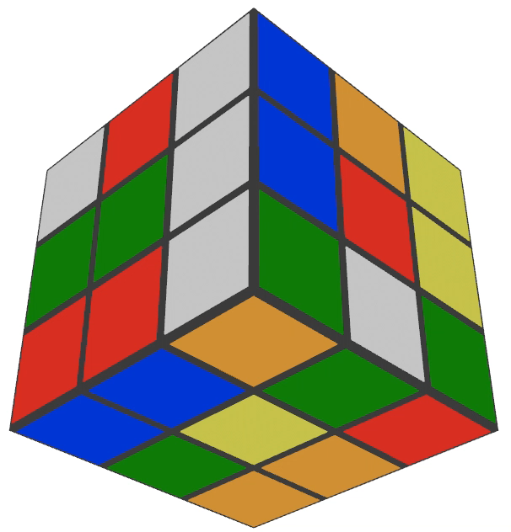
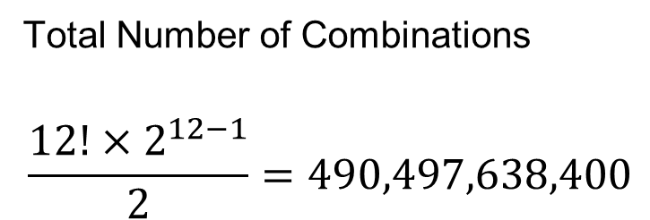
Cross
Total Number of Combinations
$$\frac{12!×2^{12−1}}{2}=490,497,638,400$$
A* Algorithm
Too many combinations!
Scientific Computing: Solving Rubiks Cube Rei TU Berlin / Zuse Institute Berlin (ZIB)

Slide 18
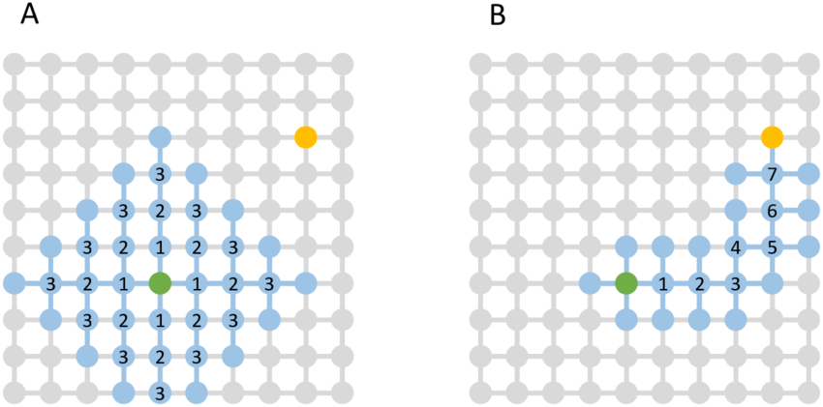
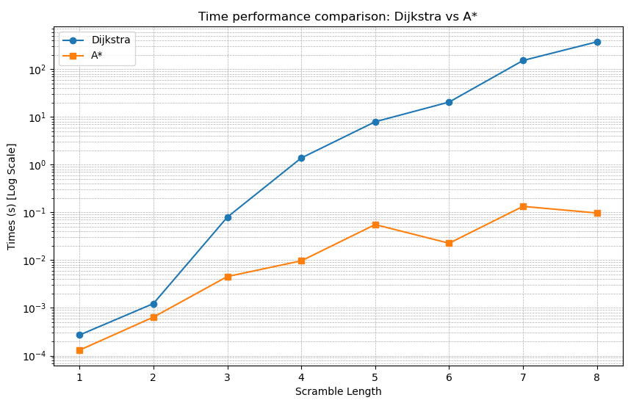
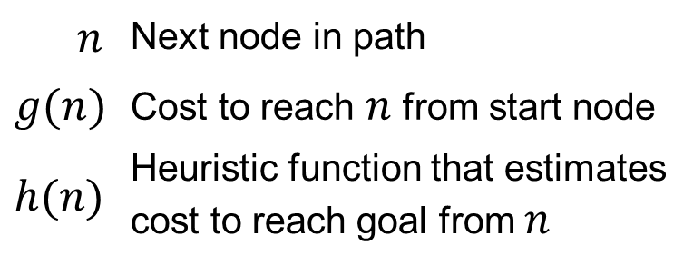
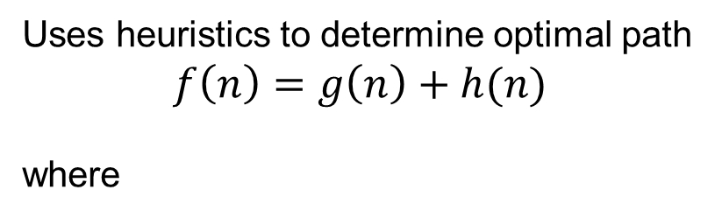
Cross (A* Algorithm)
Uses heuristics to determine optimal path
$$f\left(n\right)=g\left(n\right)+h(n)$$
where
$$n$$ | Next node in path
$$g(n)$$ | Cost to reach $n$ from start node
$$h(n)$$ | Heuristic function that estimates cost to reach goal from $n$
Scientific Computing: Solving Rubiks Cube Rei TU Berlin / Zuse Institute Berlin (ZIB)

Slide 19
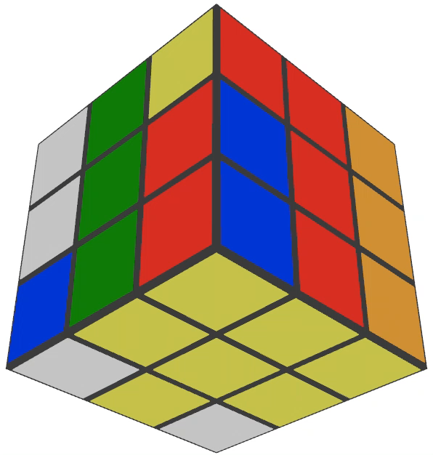
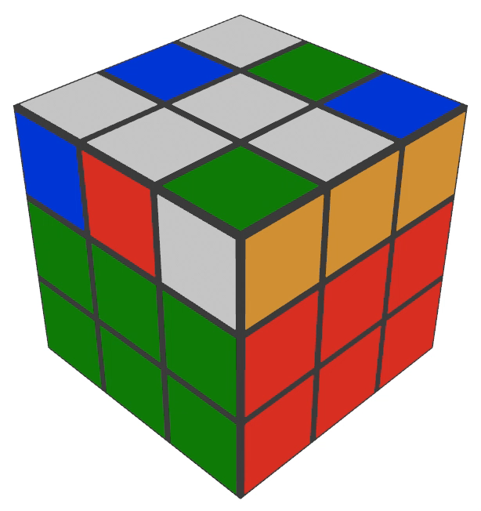
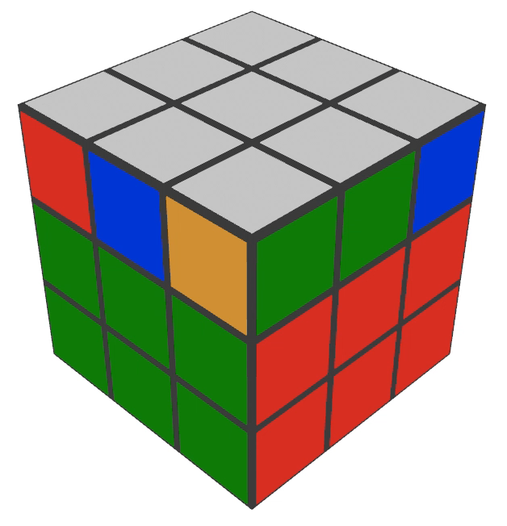
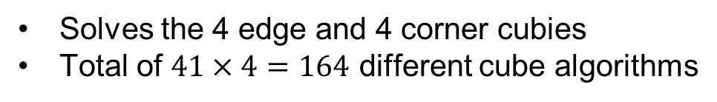
F2L, OLL, PLL
F2L
Solves the 4 edge and 4 corner cubies
Total of $41×4=164$ different cube algorithms
OLL
Correctly orients last layer
Total of 57 different cube algorithms
PLL
Correctly changes permutation of last layer
Total of 21 different cube algorithms
Scientific Computing: Solving Rubiks Cube Rei TU Berlin / Zuse Institute Berlin (ZIB)

Slide 20
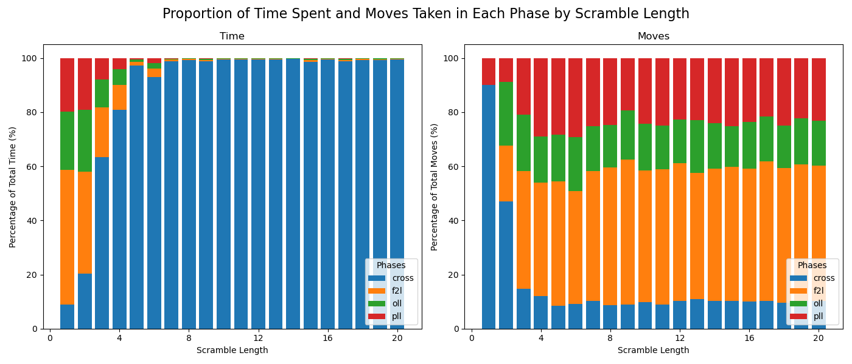
Experimental Results
Cross took the longest time to complete
F2L took the greatest number of moves
Scientific Computing: Solving Rubiks Cube Rei TU Berlin / Zuse Institute Berlin (ZIB)

Slide 21
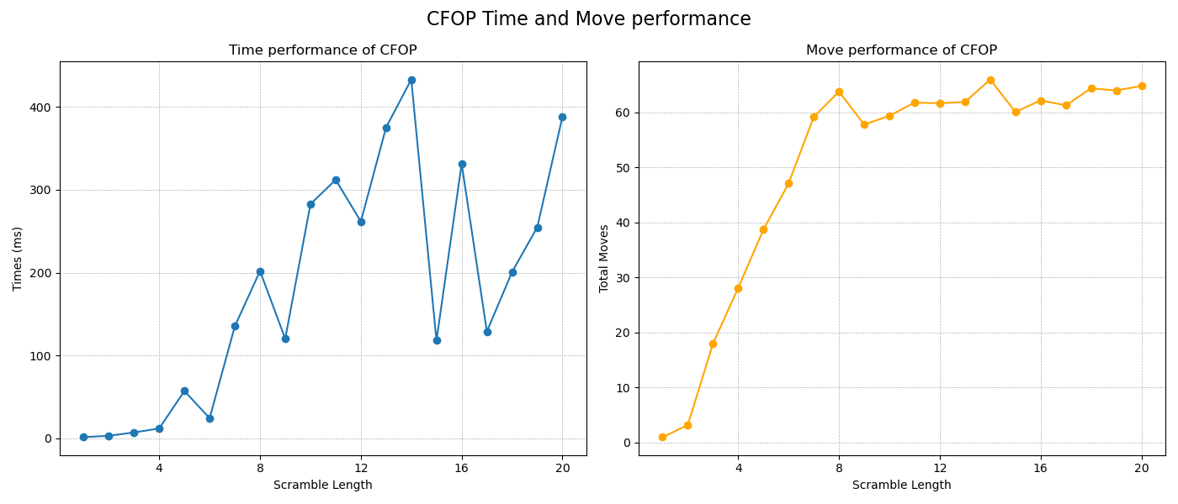
Experimental Results
Although highly erratic, CFOP method stayed under the time constraint
Move performance did not satisfy condition after scramble length of 4
Scientific Computing: Solving Rubiks Cube Rei TU Berlin / Zuse Institute Berlin (ZIB)

Slide 22
Searching Algorithm Method

Slide 23
Searching Algorithms – IDA*
Iterative Deepening A* (IDA*)
Why this algorithm?
Scientific Computing: Solving Rubiks Cube Michal TU Berlin / Zuse Institute Berlin (ZIB)

Slide 24
Searching Algorithms – IDA*
Iterative Deepening A* (IDA*)
Uses much less memory than BFS and A*
Scientific Computing: Solving Rubiks Cube Michal TU Berlin / Zuse Institute Berlin (ZIB)

Slide 25
Searching Algorithms – IDA*
Iterative Deepening A* (IDA*)
Uses much less memory than BFS and A*
Uses heuristics function to conservatively estimate the remaining cost to get to the goal
Scientific Computing: Solving Rubiks Cube Michal TU Berlin / Zuse Institute Berlin (ZIB)

Slide 26
Searching Algorithms – IDA*
Iterative Deepening A* (IDA*)
Uses much less memory than BFS and A*
Uses heuristics function to conservatively estimate the remaining cost to get to the goal
Heuristics: 3D version of the manhattan distance for sliding-tile puzzles
for each cubie compute the distance to correctly position and orient it, sum the values over all cubies and divide by 4
Scientific Computing: Solving Rubiks Cube Michal TU Berlin / Zuse Institute Berlin (ZIB)

Slide 27
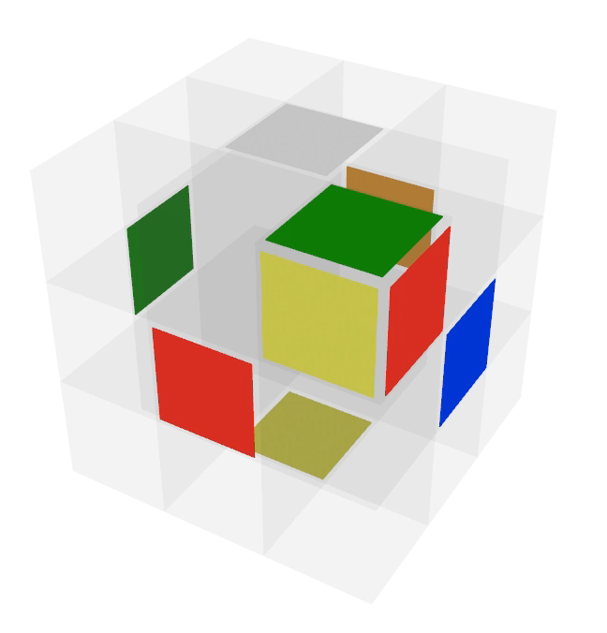
Searching Algorithms – IDA*
Iterative Deepening A* (IDA*)
Uses much less memory than BFS and A*
Uses heuristics function to conservatively estimate the remaining cost to get to the goal
Heuristics: 3D version of the manhattan distance for sliding-tile puzzles
for each cubie compute the distance to correctly position and orient it, sum the values over all cubies and divide by 4
Scientific Computing: Solving Rubiks Cube Michal TU Berlin / Zuse Institute Berlin (ZIB)

Slide 28
Searching Algorithms – IDA*
Estimated values based on experiments on
13th Gen Intel(R) Core(TM) i5-1335U
Iterative Deepening A* (IDA*)
Uses much less memory than BFS and A*
Uses heuristics function to conservatively estimate the remaining cost to get to the goal
Heuristics: 3D version of the manhattan distance for sliding-tile puzzles
for each cubie compute the distance to correctly position and orient it, sum the values over all cubies and divide by 4
depth | time
8 | 0.01s
9 | 0.05s
10 | 0.5s
11 | 5s
12 | 50s
13 | 10 min
14 | 2h
15 | 20h
16 | 200h
17 | 83 days
18 | 2 years
19 | 20 years
20 | 200 years
Scientific Computing: Solving Rubiks Cube Michal TU Berlin / Zuse Institute Berlin (ZIB)

Slide 29
Searching Algorithms – IDA*
Estimated values based on experiments on
13th Gen Intel(R) Core(TM) i5-1335U
Iterative Deepening A* (IDA*)
Uses much less memory than BFS and A*
Uses heuristics function to conservatively estimate the remaining cost to get to the goal
Heuristics: 3D version of the manhattan distance for sliding-tile puzzles
for each cubie compute the distance to correctly position and orient it, sum the values over all cubies and divide by 4
depth | time
8 | 0.01s
9 | 0.05s
10 | 0.5s
11 | 5s
12 | 50s
13 | 10 min
14 | 2h
15 | 20h
16 | 200h
17 | 83 days
18 | 2 years
19 | 20 years
20 | 200 years
We need something faster!
Scientific Computing: Solving Rubiks Cube Michal TU Berlin / Zuse Institute Berlin (ZIB)

Slide 30
Kociemba’s Two-Phase Method

Slide 31
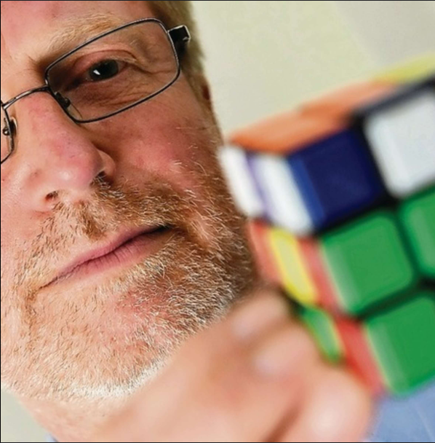
Kociemba’s Two-Phase Algorithm – General Information
Developed in 1992 by Herbert Kociemba who also was part of the team that proved that the God’s number is 20
Scientific Computing: Solving Rubiks Cube Michal TU Berlin / Zuse Institute Berlin (ZIB)

Slide 32
Kociemba’s Two-Phase Algorithm – General Information
Developed in 1992 by Herbert Kociemba who also was part of the team that proved that the God’s number is 20
Divides the Cube into two sub-puzzles, called phases
Scientific Computing: Solving Rubiks Cube Michal TU Berlin / Zuse Institute Berlin (ZIB)

Slide 33
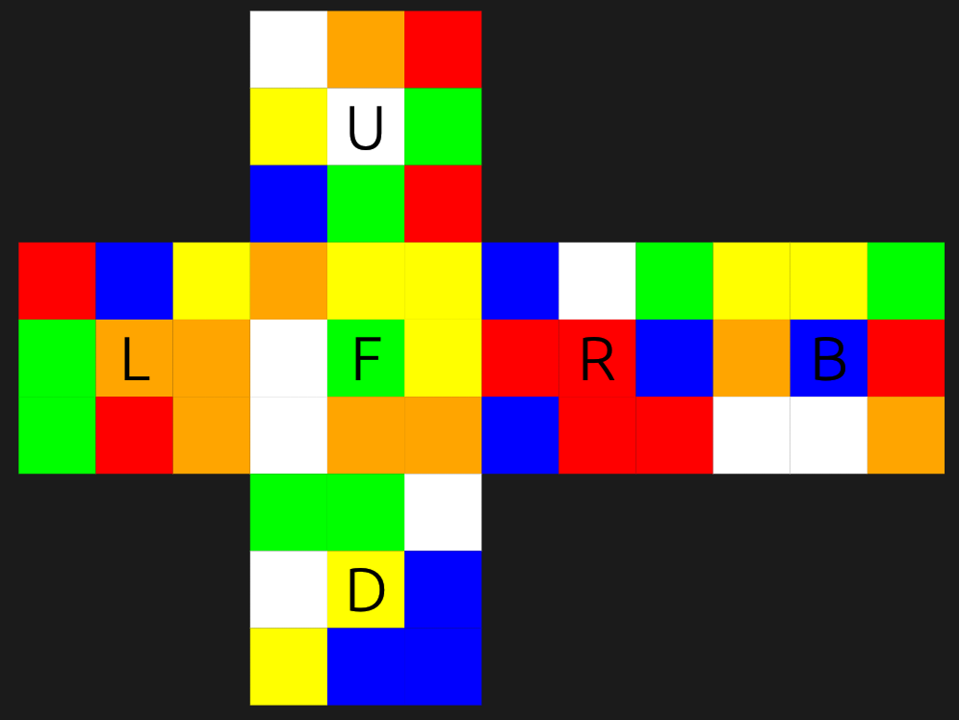
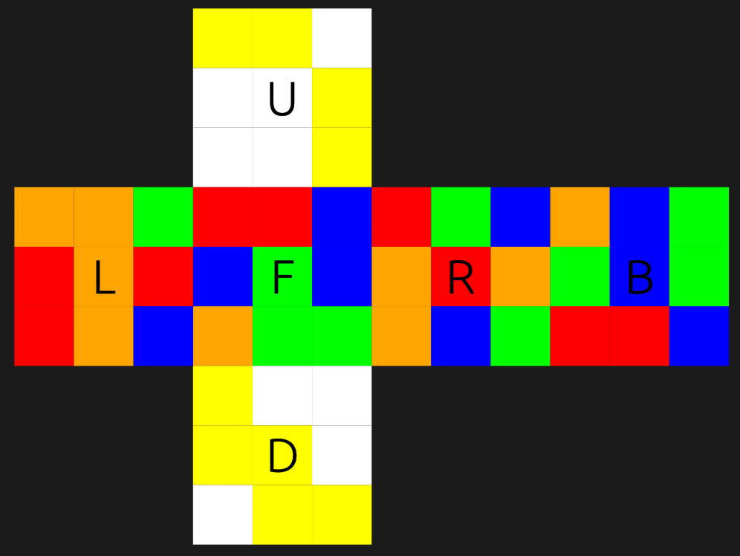
Kociemba’s Two-Phase Algorithm – General Information
Developed in 1992 by Herbert Kociemba who also was part of the team that proved that the God’s number is 20
Divides the Cube into two sub-puzzles, called phases
Phase 1 transforms the scrambled cube into a subgroup G1 that consists of all cubes that can be generated using only the moves: <U, D, F2, B2, R2, L2>
Solve Phase 1
Scrambled Cube
Cube from G1
Scientific Computing: Solving Rubiks Cube Michal TU Berlin / Zuse Institute Berlin (ZIB)

Slide 34
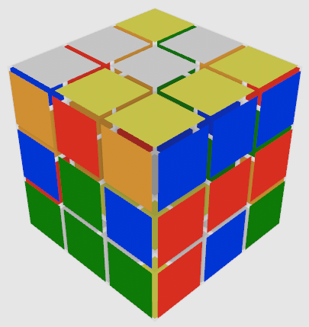
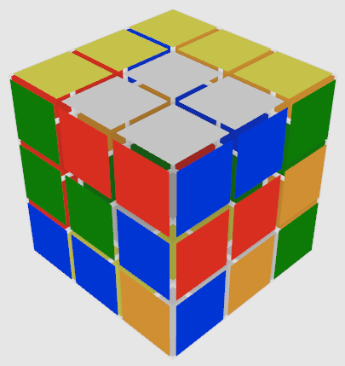
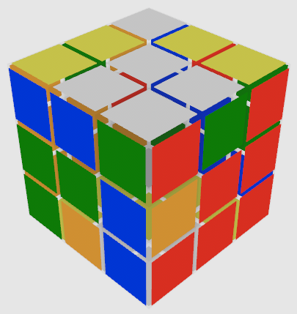
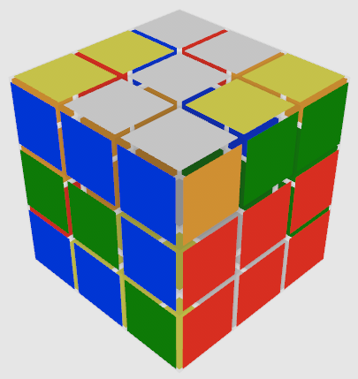
Kociemba’s Two-Phase Algorithm – General Information
Developed in 1992 by Herbert Kociemba who also was part of the team that proved that the God’s number is 20
Divides the Cube into two sub-puzzles, called phases
Phase 1 transforms the scrambled cube into a subgroup G1 that consists of all cubes that can be generated using only the moves: <U, D, F2, B2, R2, L2>
Solve Phase 1
Scrambled Cube
Cube from G1
Scientific Computing: Solving Rubiks Cube Michal TU Berlin / Zuse Institute Berlin (ZIB)

Slide 35
Kociemba’s Two-Phase Algorithm – General Information
Developed in 1992 by Herbert Kociemba who also was part of the team that proved that the God’s number is 20
Divides the Cube into two sub-puzzles, called phases
Phase 1 transforms the scrambled cube into a subgroup G1 that consists of all cubes that can be generated using only the moves: <U, D, F2, B2, R2, L2>
→ All Corners and Edges in the U and D slice have the correct orientation
→ All Edges from the E-Slice (Middle Slice between U and D slices) stay isolated in the E-Slice
Solve Phase 1
Scrambled Cube
Cube from G1
Scientific Computing: Solving Rubiks Cube Michal TU Berlin / Zuse Institute Berlin (ZIB)

Slide 36
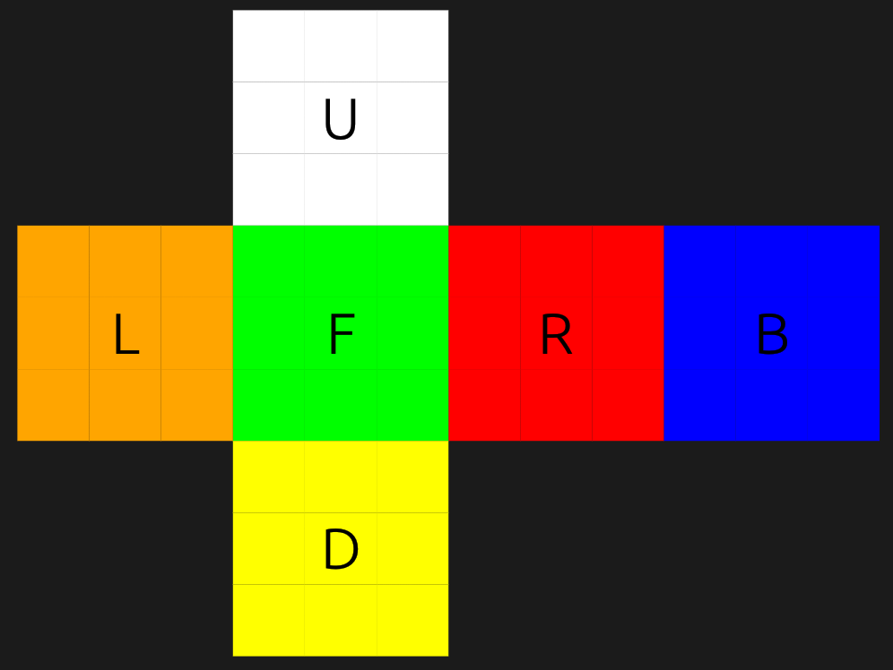
Kociemba’s Two-Phase Algorithm – General Information
Developed in 1992 by Herbert Kociemba who also was part of the team that proved that the God’s number is 20
Divides the Cube into two sub-puzzles, called phases
Phase 1 transforms the scrambled cube into a subgroup G1 that consists of all cubes that can be generated using only the moves: <U, D, F2, B2, R2, L2>
Phase 2 solves the cube from G1 using only the moves <U, D, F2, B2, R2, L2>
Solve Phase 1
Solve Phase 2
Scrambled Cube
Cube from G1
Solved Cube
Scientific Computing: Solving Rubiks Cube Michal TU Berlin / Zuse Institute Berlin (ZIB)

Slide 37
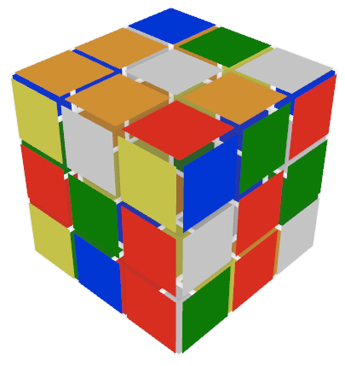
Kociemba’s Two-Phase Algorithm – coordinate-level representation
Idea: Describe the permutations and the orientations of the cubies by unique natural numbers.
Corner permutation coordinate = 30744
Corner orientation coordinate = 379
Edge permutation coordinate = 23432
Edge orientation coordinate = 650
And more...
Scientific Computing: Solving Rubiks Cube Michal TU Berlin / Zuse Institute Berlin (ZIB)

Slide 38
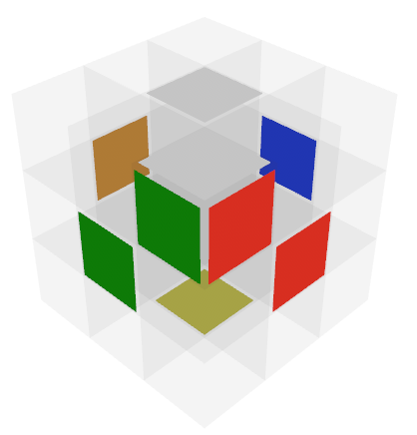
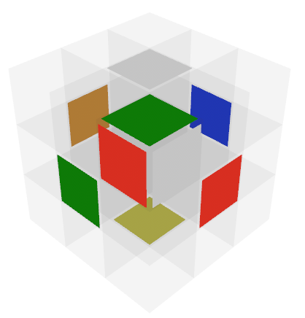
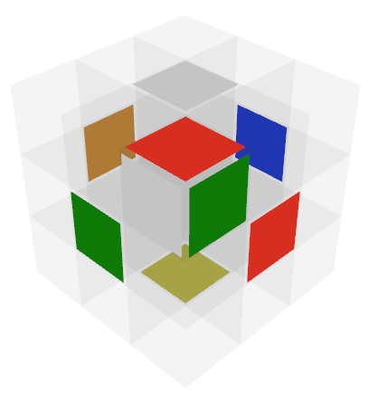
Kociemba’s Two-Phase Algorithm – coordinate-level representation
Idea: Describe the permutations and the orientations of the cubies by unique natural numbers.
Phase 1
Corner orientation coordinate a
Edge orientation coordinate b
E-Slice phase 1 coordinate c
Scientific Computing: Solving Rubiks Cube Michal TU Berlin / Zuse Institute Berlin (ZIB)

Slide 39
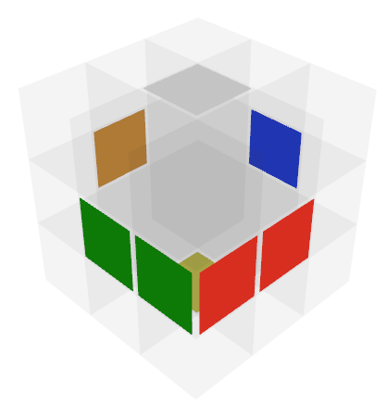
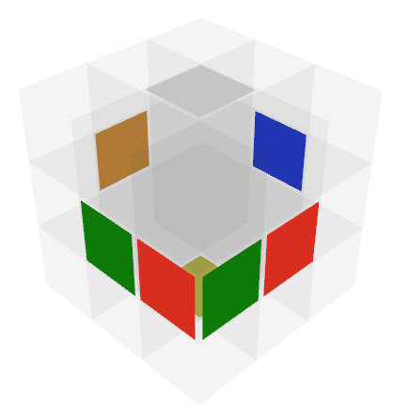
Kociemba’s Two-Phase Algorithm – coordinate-level representation
Idea: Describe the permutations and the orientations of the cubies by unique natural numbers.
Phase 1
Corner orientation coordinate a
Edge orientation coordinate b
E-Slice phase 1 coordinate c
Scientific Computing: Solving Rubiks Cube Michal TU Berlin / Zuse Institute Berlin (ZIB)

Slide 40
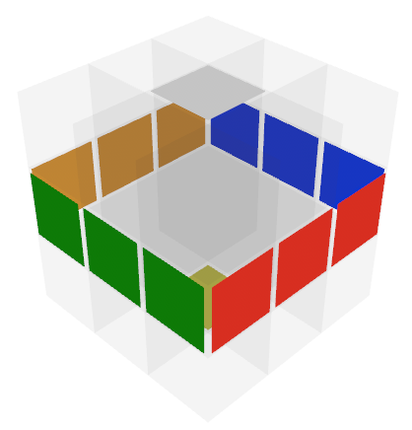
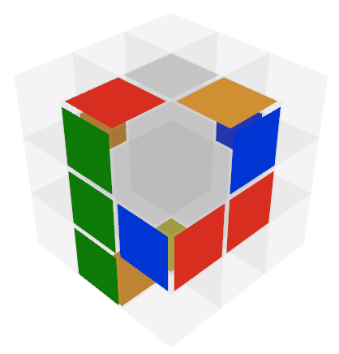
Kociemba’s Two-Phase Algorithm – coordinate-level representation
Idea: Describe the permutations and the orientations of the cubies by unique natural numbers.
Phase 1
Corner orientation coordinate a
Edge orientation coordinate b
E-Slice phase 1 coordinate c
Scientific Computing: Solving Rubiks Cube Michal TU Berlin / Zuse Institute Berlin (ZIB)

Slide 41
Kociemba’s Two-Phase Algorithm – coordinate-level representation
Idea: Describe the permutations and the orientations of the cubies by unique natural numbers.
Phase 1
Corner orientation coordinate a
Edge orientation coordinate b
E-Slice phase 1 coordinate c
Scientific Computing: Solving Rubiks Cube Michal TU Berlin / Zuse Institute Berlin (ZIB)

Slide 42
Kociemba’s Two-Phase Algorithm – coordinate-level representation
Idea: Describe the permutations and the orientations of the cubies by unique natural numbers.
Phase 1
Corner orientation coordinate a
Edge orientation coordinate b
E-Slice phase 1 coordinate c
Goal state of phase 1 is a cube from G1, any cube from G1 has the same unique phase 1 coordinates (a,b,c) = (a0,b0,c0)
Scientific Computing: Solving Rubiks Cube Michal TU Berlin / Zuse Institute Berlin (ZIB)

Slide 43
Kociemba’s Two-Phase Algorithm– coordinate-level representation
Idea: Describe the permutations and the orientations of the cubies by unique natural numbers.
Phase 1
Corner orientation coordinate a
Edge orientation coordinate b
E-Slice phase 1 coordinate c
Goal state of phase 1 is a cube from G1, any cube from G1 has the same unique phase 1 coordinates (a,b,c) = (a0,b0,c0)
Problem space of phase 1 consists of 2,217,093,120 different states
Scientific Computing: Solving Rubiks Cube Michal TU Berlin / Zuse Institute Berlin (ZIB)

Slide 44
Kociemba’s Two-Phase Algorithm – coordinate-level representation
Idea: Describe the permutations and the orientations of the cubies by unique natural numbers.
Phase 1
Corner orientation coordinate a
Edge orientation coordinate b
E-Slice phase 1 coordinate c
Goal state of phase 1 is a cube from G1, any cube from G1 has the same unique phase 1 coordinates (a,b,c) = (a0,b0,c0)
Problem space of phase 1 consists of 2,217,093,120 different states
Phase 2
Corner permutation coordinate a’
Edge permutation coordinate b’
E-Slice phase 2 coordinate c’
Scientific Computing: Solving Rubiks Cube Michal TU Berlin / Zuse Institute Berlin (ZIB)

Slide 45
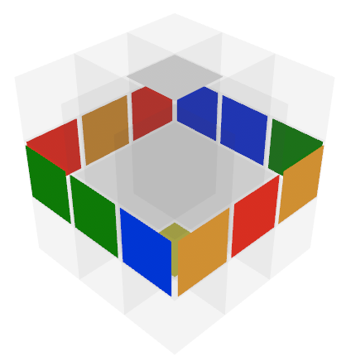
Kociemba’s Two-Phase Algorithm – coordinate-level representation
Idea: Describe the permutations and the orientations of the cubies by unique natural numbers.
Phase 1
Corner orientation coordinate a
Edge orientation coordinate b
E-Slice phase 1 coordinate c
Goal state of phase 1 is a cube from G1, any cube from G1 has the same unique phase 1 coordinates (a,b,c) = (a0,b0,c0)
Problem space of phase 1 consists of 2,217,093,120 different states
Phase 2
Corner permutation coordinate a’
Edge permutation coordinate b’
E-Slice phase 2 coordinate c’
Scientific Computing: Solving Rubiks Cube Michal TU Berlin / Zuse Institute Berlin (ZIB)

Slide 46
Kociemba’s Two-Phase Algorithm – coordinate-level representation
Idea: Describe the permutations and the orientations of the cubies by unique natural numbers.
Phase 1
Corner orientation coordinate a
Edge orientation coordinate b
E-Slice phase 1 coordinate c
Goal state of phase 1 is a cube from G1, any cube from G1 has the same unique phase 1 coordinates (a,b,c) = (a0,b0,c0)
Problem space of phase 1 consists of 2,217,093,120 different states
Phase 2
Corner permutation coordinate a’
Edge permutation coordinate b’
E-Slice phase 2 coordinate c’
Scientific Computing: Solving Rubiks Cube Michal TU Berlin / Zuse Institute Berlin (ZIB)

Slide 47
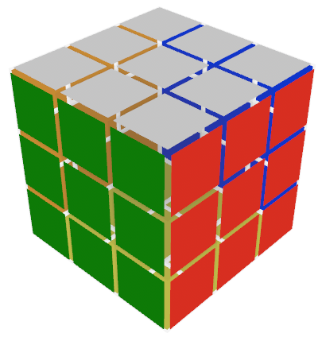
Kociemba’s Two-Phase Algorithm – coordinate-level representation
Idea: Describe the permutations and the orientations of the cubies by unique natural numbers.
Phase 1
Corner orientation coordinate a
Edge orientation coordinate b
E-Slice phase 1 coordinate c
Goal state of phase 1 is a cube from G1, any cube from G1 has the same unique phase 1 coordinates (a,b,c) = (a0,b0,c0)
Problem space of phase 1 consists of 2,217,093,120 different states
Phase 2
Corner permutation coordinate a’
Edge permutation coordinate b’
E-Slice phase 2 coordinate c’
Goal state of phase2 is a solved cube with unique phase 2 coordinates (a’,b’,c’) = (a0’,b0’,c0’)
Scientific Computing: Solving Rubiks Cube Michal TU Berlin / Zuse Institute Berlin (ZIB)

Slide 48
Kociemba’s Two-Phase Algorithm – coordinate-level representation
Idea: Describe the permutations and the orientations of the cubies by unique natural numbers.
Phase 1
Corner orientation coordinate a
Edge orientation coordinate b
E-Slice phase 1 coordinate c
Goal state of phase 1 is a cube from G1, any cube from G1 has the same unique phase 1 coordinates (a,b,c) = (a0,b0,c0)
Problem space of phase 1 consists of 2,217,093,120 different states
Phase 2
Corner permutation coordinate a’
Edge permutation coordinate b’
E-Slice phase 2 coordinate c’
Goal state of phase2 is a solved cube with unique phase 2 coordinates (a’,b’,c’) = (a0’,b0’,c0’)
Problem space of phase 2 consists 19,508,428,800 different states
Scientific Computing: Solving Rubiks Cube Michal TU Berlin / Zuse Institute Berlin (ZIB)

Slide 49
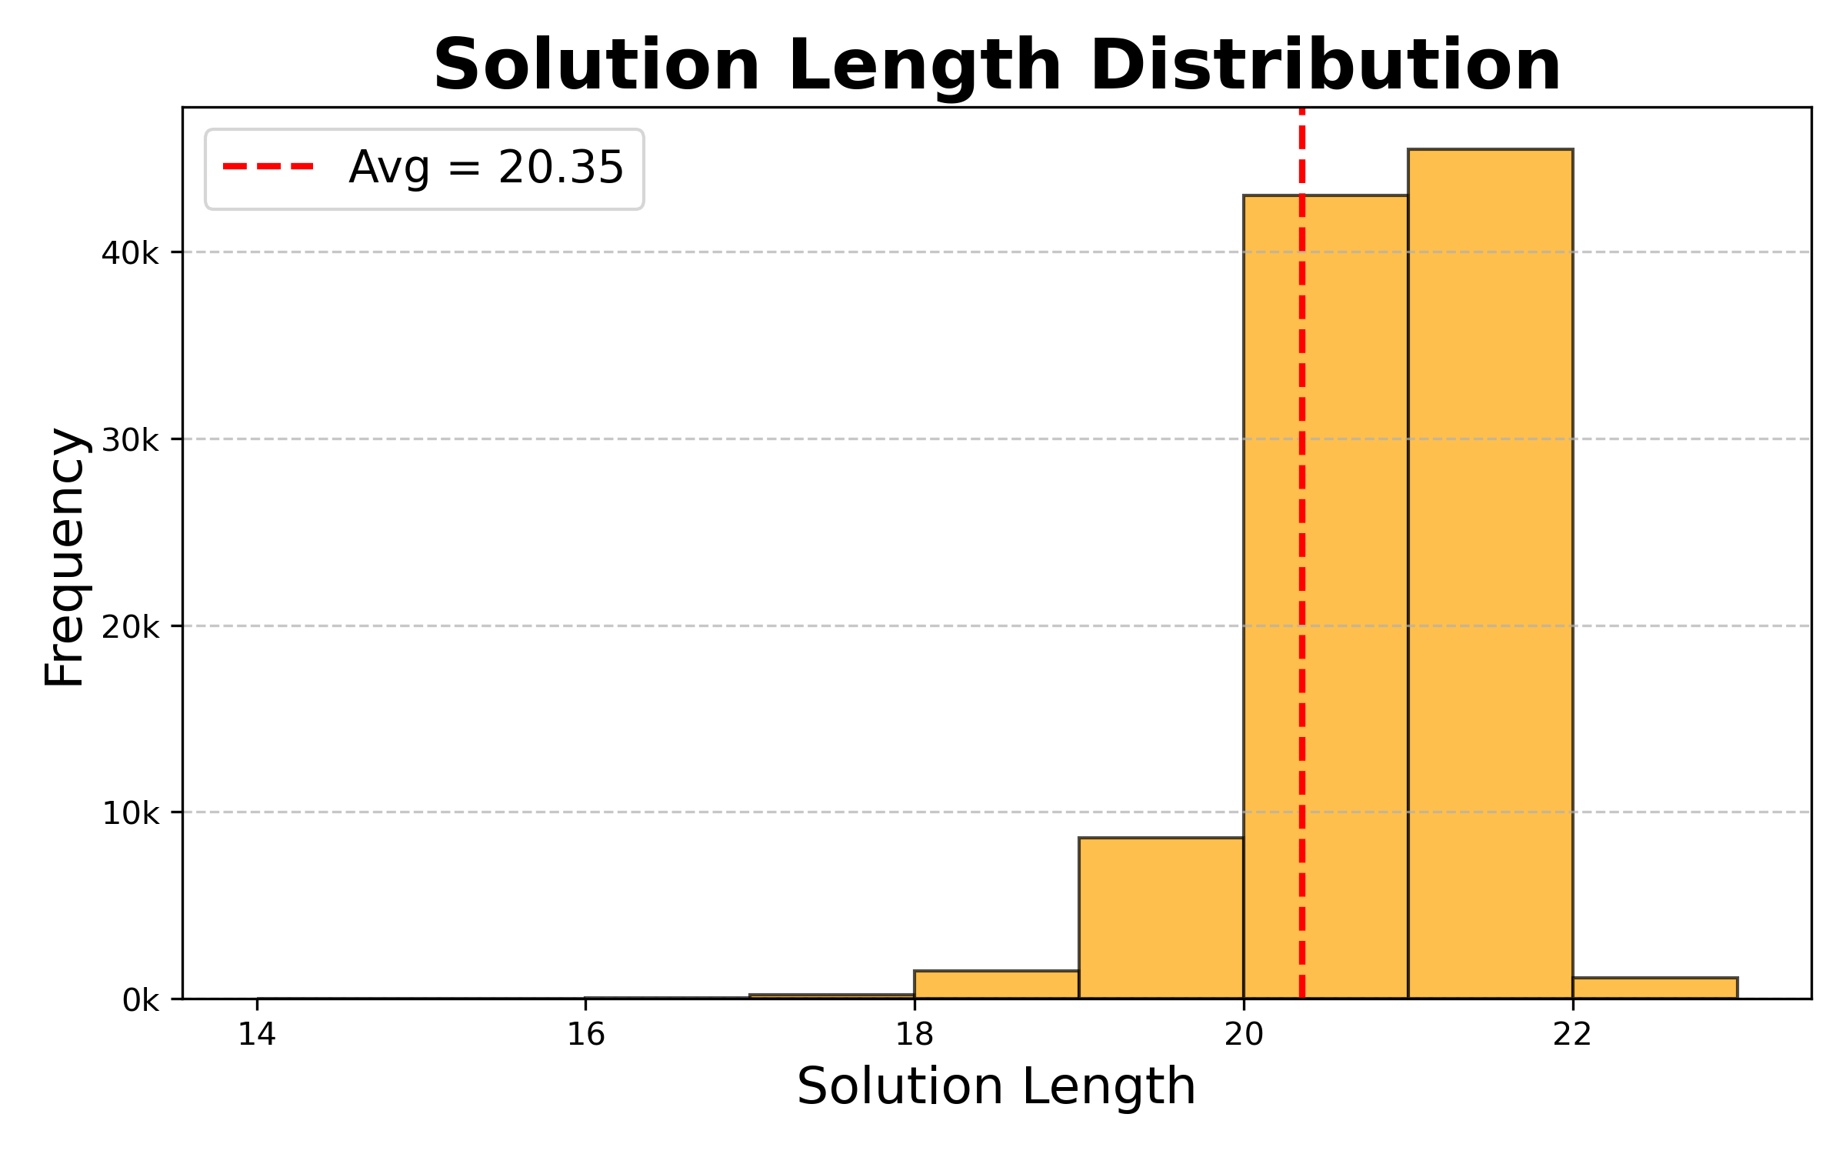
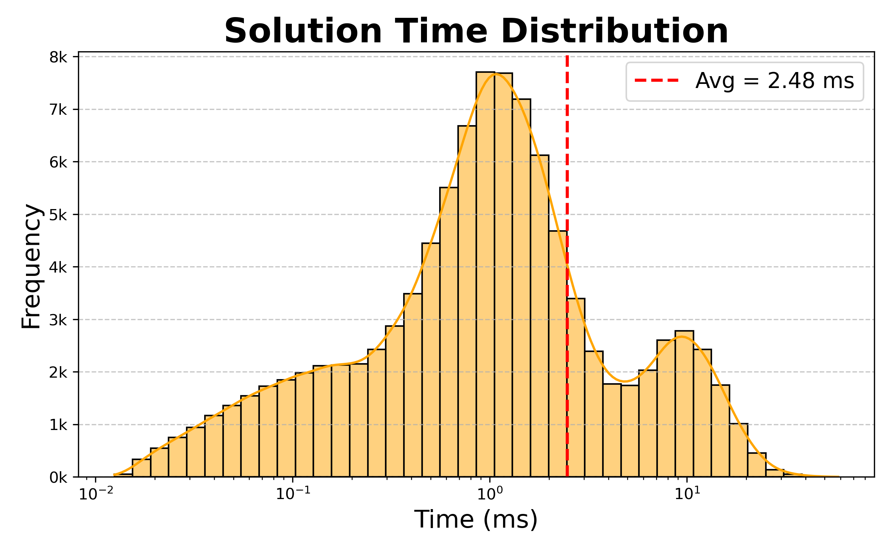
Kociemba’s Two-Phase Algorithm – Performance
100k random scrambles were investigated
The shortest solution required 14 moves, the longest 22.
The fastest solution computed in 12µs, the slowest in 58 ms
Scientific Computing: Solving Rubiks Cube Michal TU Berlin / Zuse Institute Berlin (ZIB)

Slide 50
Neural Network Method

Slide 51

Idea
Scientific Computing: Solving Rubiks Cube Malte TU Berlin / Zuse Institute Berlin (ZIB)

Slide 52

Architecture
Neural network
Input: Vector of length 54
Output: number of moves to solve
Feedforward, 1 hidden layer
Scientific Computing: Solving Rubiks Cube Malte TU Berlin / Zuse Institute Berlin (ZIB)

Slide 53


Results
Scientific Computing: Solving Rubiks Cube Malte TU Berlin / Zuse Institute Berlin (ZIB)

Slide 54

Reinforcement Learning
Training an agent
Inefficient reward
Local optima
To shallow network
Scientific Computing: Solving Rubiks Cube Malte TU Berlin / Zuse Institute Berlin (ZIB)

Slide 55
Conclusion

Slide 56
Overall Performance
Method | Time Performance | Move Performance
CFOP
IDA*
Kociemba
Neural Network
Scientific Computing: Solving Rubiks Cube Malte TU Berlin / Zuse Institute Berlin (ZIB)

